Slide 1
Object Oriented Programming Lab CSE 1206
Lab 5

Slide 2
Type Conversion and Casting

Slide 3
Type Promotion Rules
When two types are compatible and destination type is larger than source type.
byte -> short || int || long || float || double
short -> int || long || float || double
char -> int || long || float || double
int -> long || float ||double
long -> float || double
float -> double
*Read Type Conversion and Casting in Chapter 3 from the book Java The Complete Reference by Herbert Schildt.
(Page 48 to 51 in eight edition)

Slide 4
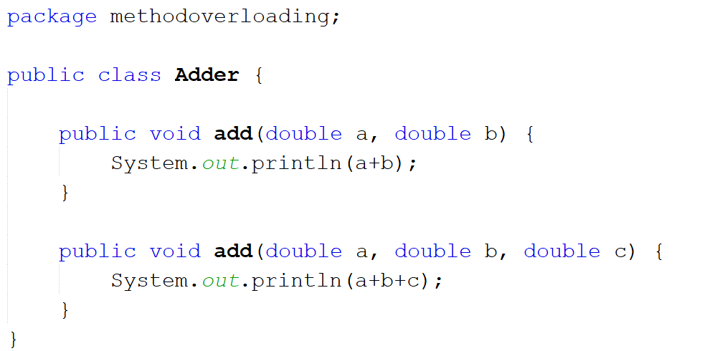

Slide 5
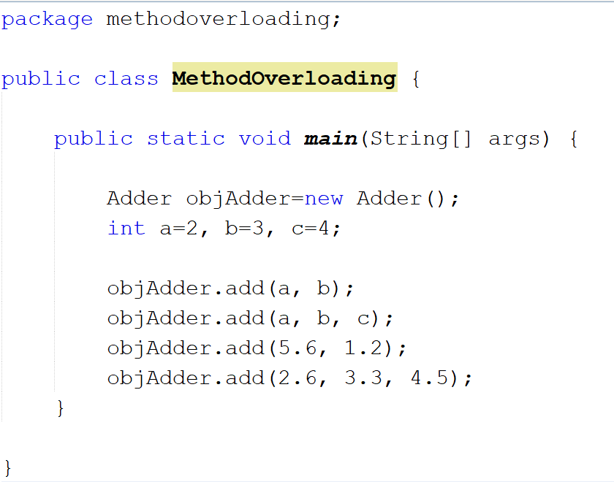
Although Integers but Java automatically converts them to double

Slide 6
Type Casting
When two types are incompatible and destination type is smaller than source type, we do type casting to convert them.
(target-type) value
Example:
double num1= (int) 5.8;

Slide 7
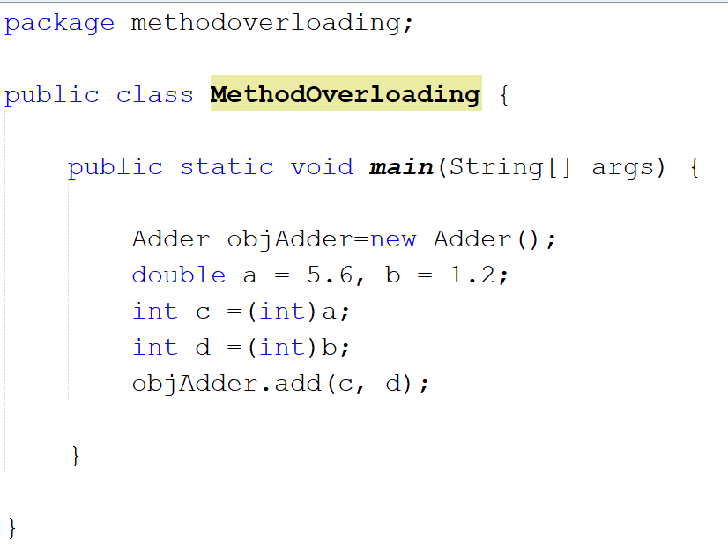

Slide 8
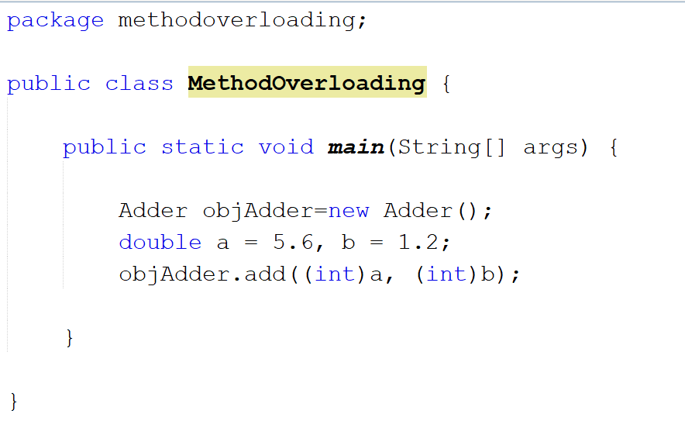

Slide 9
One Dimensional Arrays
Create a new Project Named TestArray.

Slide 10
Declaring Arrays
dataType array[];
dataType[] array;
dataType []array;
Instantiation of an Array in java
array=new datatype[size]; size-> integer value
*new keyword allocates memory to the array.

Slide 11
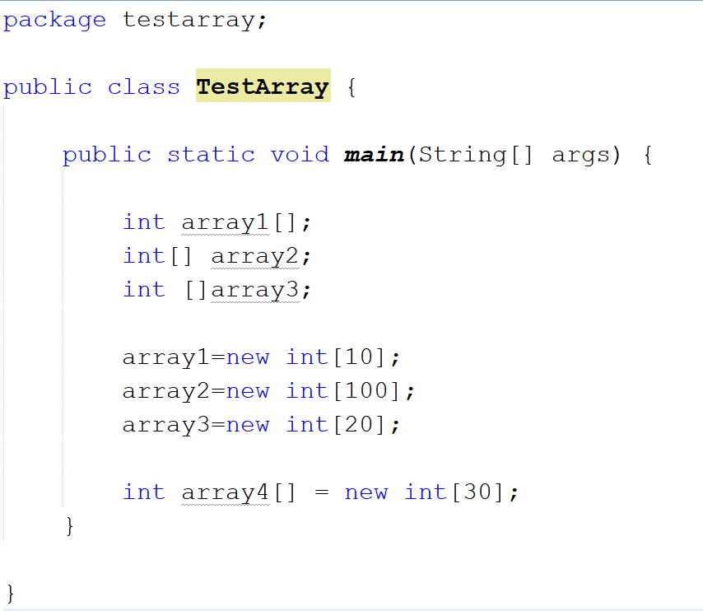

Slide 12
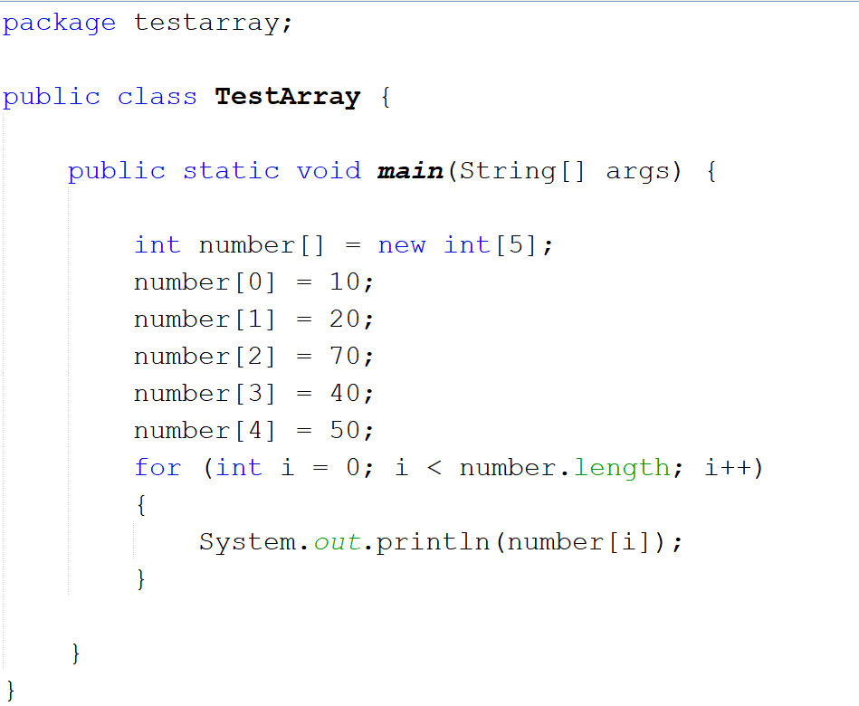
Way-1

Slide 13
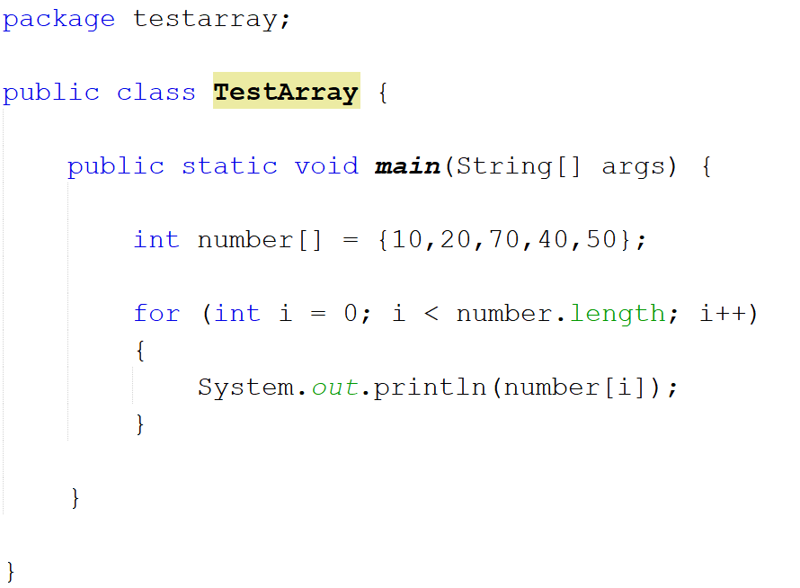
Way-2

Slide 14
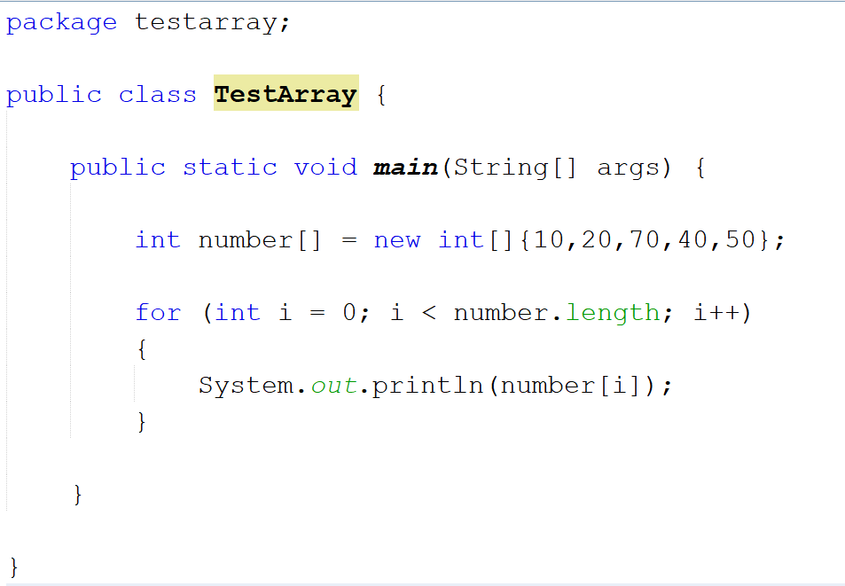
Way-3

Slide 15
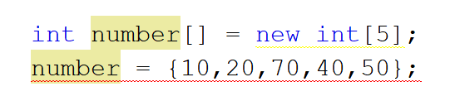
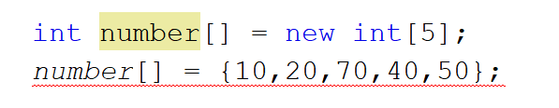
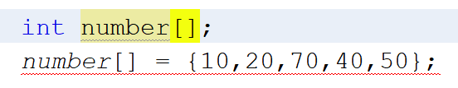
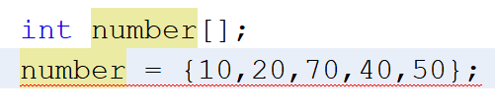
But you cannot initialize array like this

Slide 16
Using Arrays as Method Parameters

Slide 17
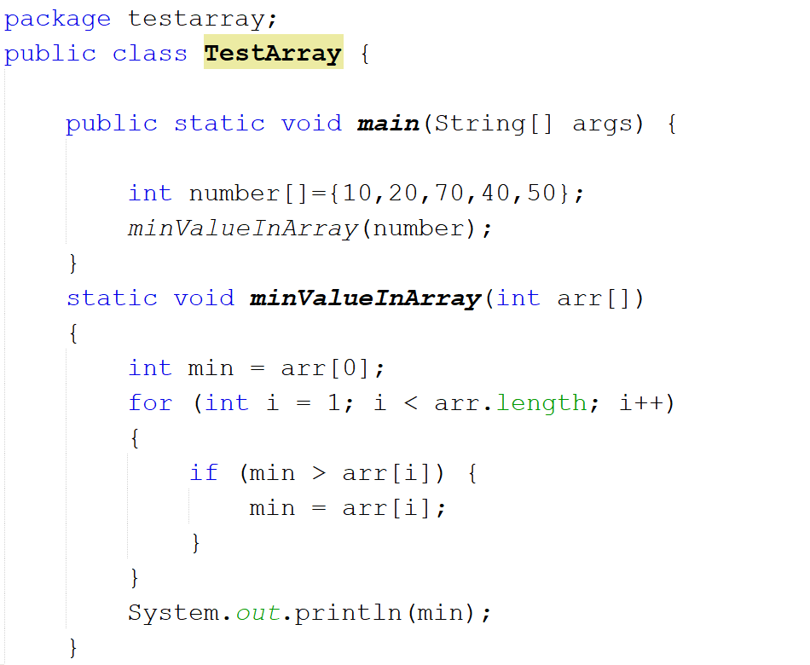

Slide 18
Using Arrays as Return Type of Method

Slide 19
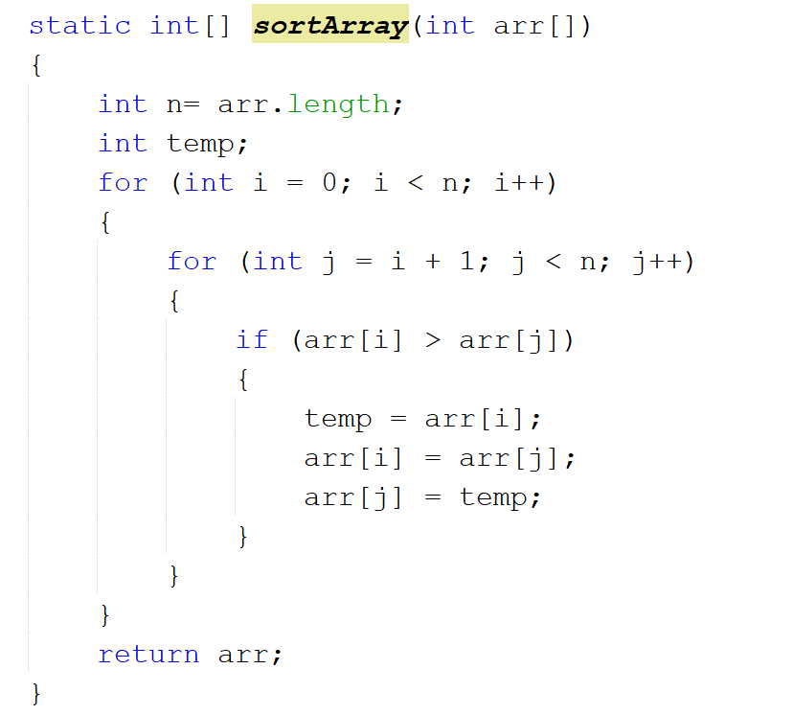

Slide 20
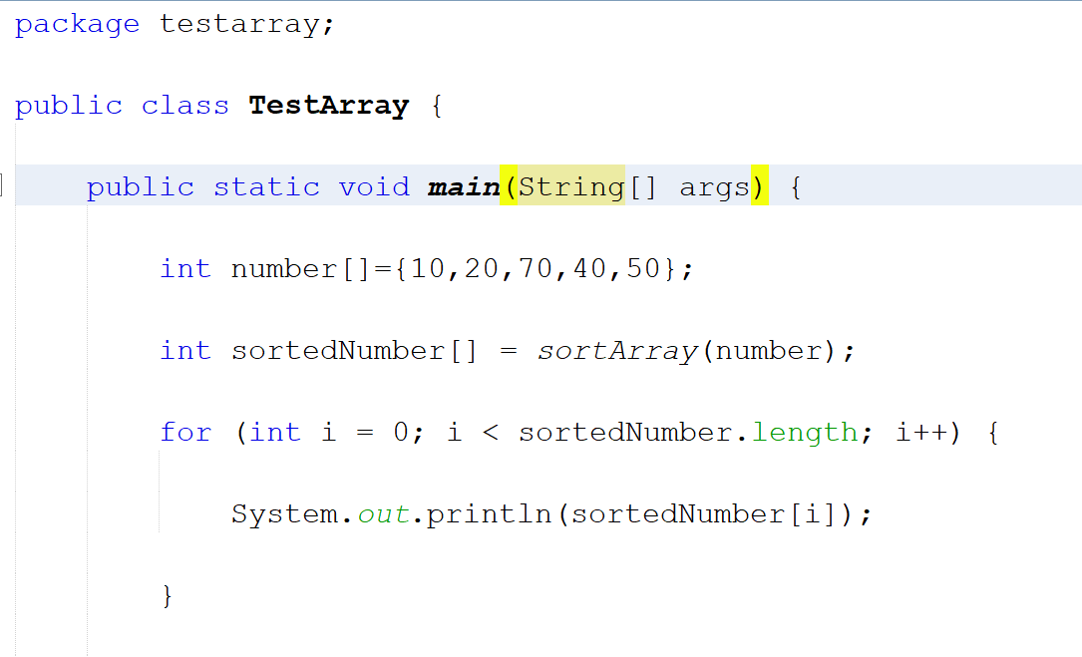

Slide 21
User Input for Array Elements

Slide 22
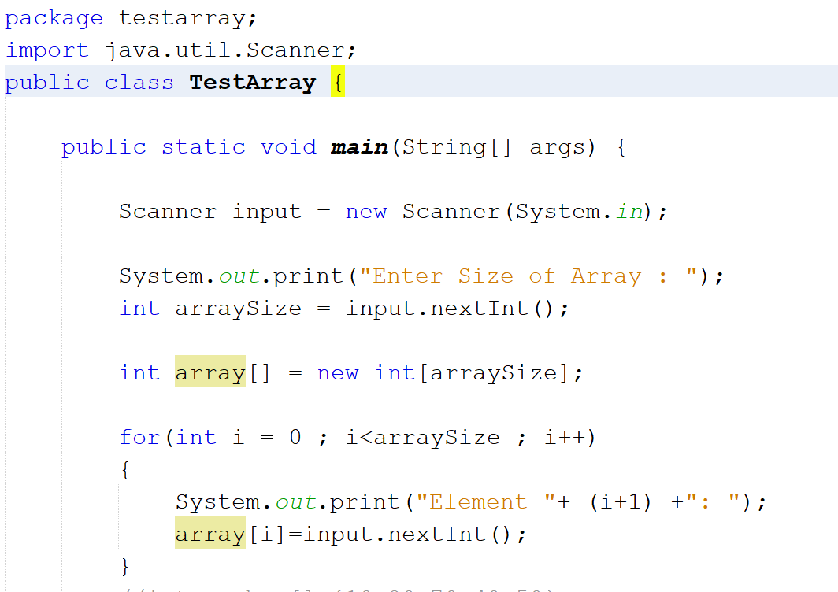

Slide 23
Array of Objects
Now Create a new Project Named TestEmployee and Create a New Class named Employee within the same project.

Slide 24
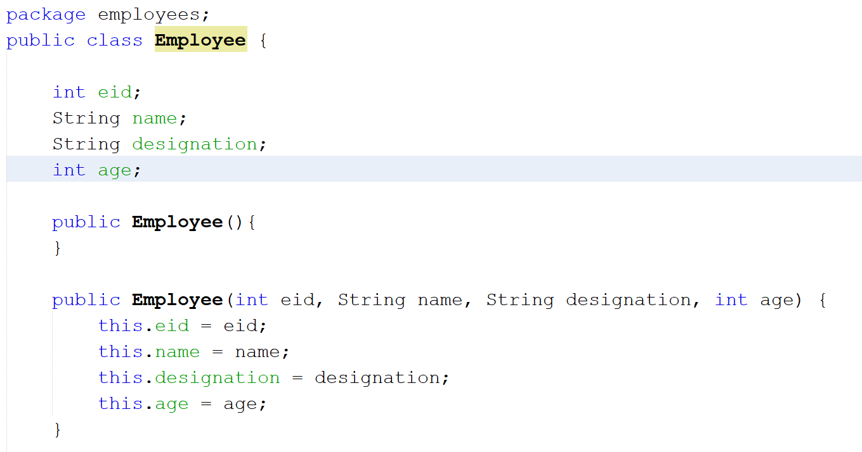

Slide 25
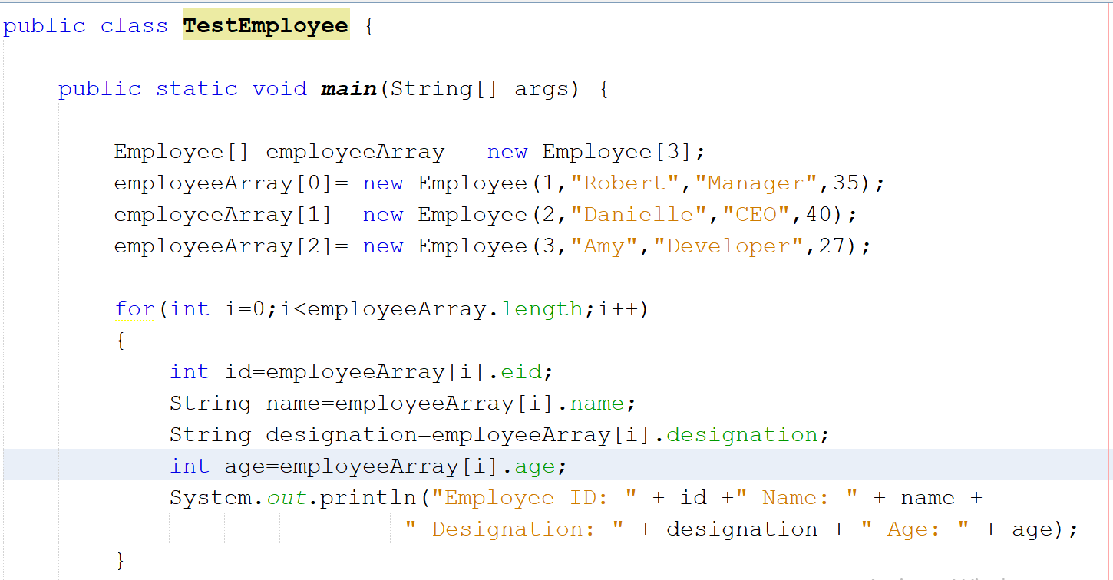

Slide 26
Now we will search for an employee from this employee array using method overloading concept.
The Search will Occur in 3 ways:
Search by EID
Search by Name
Search by Designation and Age

Slide 27
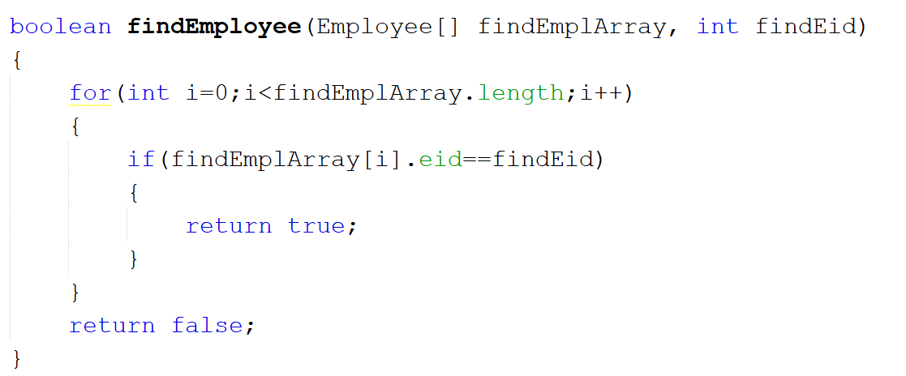
Method-1: Search Using EID

Slide 28
Try to create the other methods yourself
Strings are compared using ‘equals’ keyword instead of ‘==’
Example: str1.equals(str2)

Slide 29
Multidimensional Arrays

Slide 30
Declaring two-dimensional Arrays
dataType[][] multiArray;
dataType [][]multiArray;
dataType multiArray[][];
dataType []multiArray[];
Instantiation of an Array in java
datatype [][]multiArray=new datatype[size][size];
new keyword allocates memory to the array.

Slide 31
Declaring multidimensional Arrays
dataType[][][] multiArray;
dataType [][][]multiArray;
dataType multiArray[][][];
dataType []multiArray[][];
Instantiation of an Array in java
datatype multiArray[][][] =new datatype[size][size][size];

Slide 32
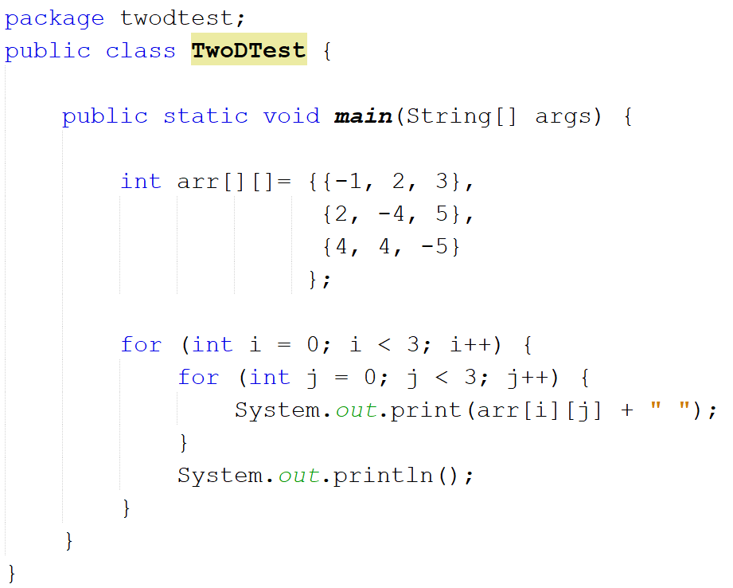

Slide 33
 | Column 0 | Column 1 | Column 2
Row 0 | -1 arr[0][0] | 2 arr[0][1] | 3 arr[0][2]
Row 1 | 2 arr[1][0] | -4 arr[1][1] | 5 arr[1][2]
Row 2 | 4 arr[2][0] | 4 arr[2][1] | -5 arr[2][2]

Slide 34
Write a Program to Add, Subtract, Multiply two 3x3 matrices

